Slide 1


SDMAY25-10
PROBLEM &
USERS
TESSA LANZEL, PAIGE SCHNEIDER, MOLLY ROONEY, MAY EDEL, ELICIA BARANOWSKI, ALEXANDRA RAUER, JOSHUA CHIANG FUNG

Slide 2
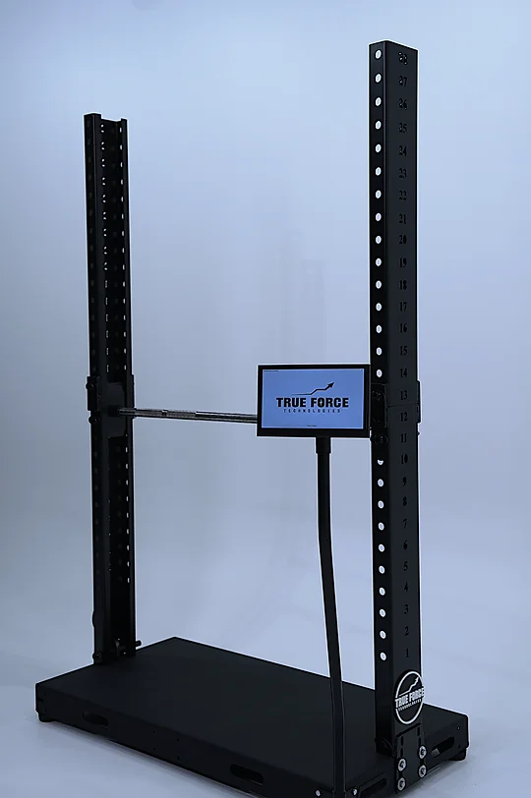



OVERVIEW
Develop a mobile application for both Google Play Store and Apple App store using their native language
Apps will connect to existing firmware and database to display and store user’s force output for each lift and metrics over a period of time

Slide 3

PROBLEM
STATEMENT
  Unknown knowledge for what weights will improve strength without injuring
  Current data is not transferable across devices
  No security
  Current Application is full of bugs
  Availibity to users

Slide 4
HEARS
Loud Noises
Encouragement to Lift More
Performance Metrics
  Slamming Weights
  Coaches/Athletes Yelling
  Music Blasting
  Told whether they are meeting their goals or not
Told to fix technique
Feedback from Coaches
Criticism from fans
  Have better form on exercises

Slide 5
SEES
Teammates
Coaches
Competitors
  Lifting
  Stretching
  Practicing
  Strength & Conditioning
  Trainers
  Nutrition
  Assistant / Head
Lots of Numbers
Heavier Weight
Gym
  Force / Strength
  Scores
  Goals being achieved
  Improvement
  Weight room
  Practice room

Slide 6
SAYS & DOES
Trains
Talks to Teammates
Stresses
  According to schedule from coaches
  Encourages
  Competes against
  Nervous / anxious to compete
Feedback
  Gives feedback / ways to improve

Slide 7
THINKS & FEELS
Tired
Feels Strong
Confused on Tracking Data
  Overworked
  Balancing classes and athletics
  Gaining Muscles
  How the the data works?
  What do the metrics tell me?
“I need to train harder”
“I’m not making progress”
“My athletes are fatigued“

Slide 8

PAINS
NO CUSTOM TRAINING PLAN FOR EACH ATHLETE
HARD TO TRACK GOALS / ACHIEVEMENTS
SEPARATING DIFFERENT ATHLETES’ PROGRESS
DIFFERING STRENGTH LEVELS EACH DAY
CURRENT APPLICATION IS VERY BUGS

Slide 9
GAINS
TECHNOLOGY MORE ACCESIBLE TO EACH ATHLETE
UPDATE CURRENT APP TO DISPLAY DATA IN AN EASIER TO READ GRAPH
IMPROVE ATHLETE PERFORMANCE BY ACCURATELY TRACKING METRICS

Slide 10
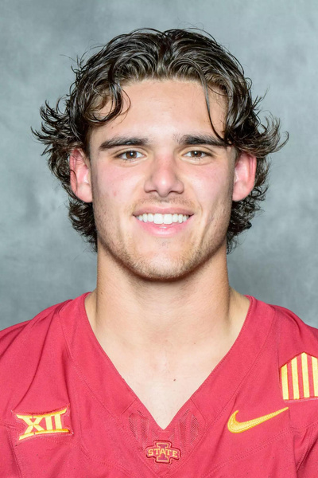
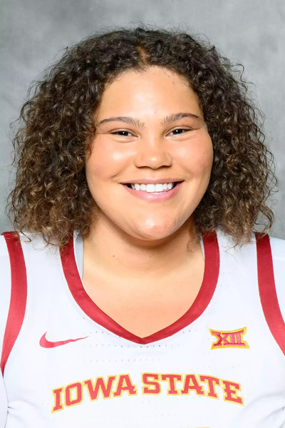
PERSONAS
Rocco Becht
  Trying to balance school and athletics
  Want to perform their best in competitions and takes training seriously
  Be at their peak physically but not risk getting injured
  Worry about the expectations from teammates and coaches
Age: 18-22
Occupation: In-Season Student Athlete
Location: Ames, IA
Audi Crooks
  Student athlete who is in their offseason
  Less stressed about competing, so their focus in currently on getting stronger for their season next year
  Working hard but less fatigued as when in season
Age: 18-22
Occupation: Off- Season Student Athlete
Location: Ames, IA

Slide 11
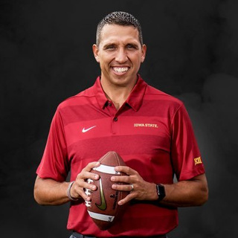
PERSONAS
Coach Campbell
  College Athletics Coach
  Responsible for balancing many athletes at once
  Get each individual athlete stronger with the goal of making the team stronger
  Pressure from donors, athletes, conference, and other coaches
Age: 40
Occupation: College Athletics Coach
Location: Ames, IA

Slide 12


USER NEEDS
INFORMATION IS FORMATTED TO BE EASILY UNDERSTOOD
EASY TO READ LIFTS
TRACK PROGRESS & READ RECORDS FOR EACH ATHLETE
COACHES ARE ABLE TO SEE AND ADD ATHLETES EASILY
NO TEAMS CAN SEE OTHER ATHLETE’S PROGRESS
EASY TO USE DESIGN

Slide 13


CONCLUSIONS
For current phase of design and development: Users are athletes and coaches
    Usually tired, overworking
    Intense training environment
    Focused on improvement
Differences between on and off season athletes
    On season: more stressed to compete while juggling school
    Off Season: more focused on strength training and less stressed
This encourages a design that is easy to use and simple to understand, to not add to the stress of athletes and coaches

Slide 14

QUESTIONS?

